Slide 1

Advanced Lighting
3D Graphics and Gamification
dr. Riaan oberholzer

Slide 2
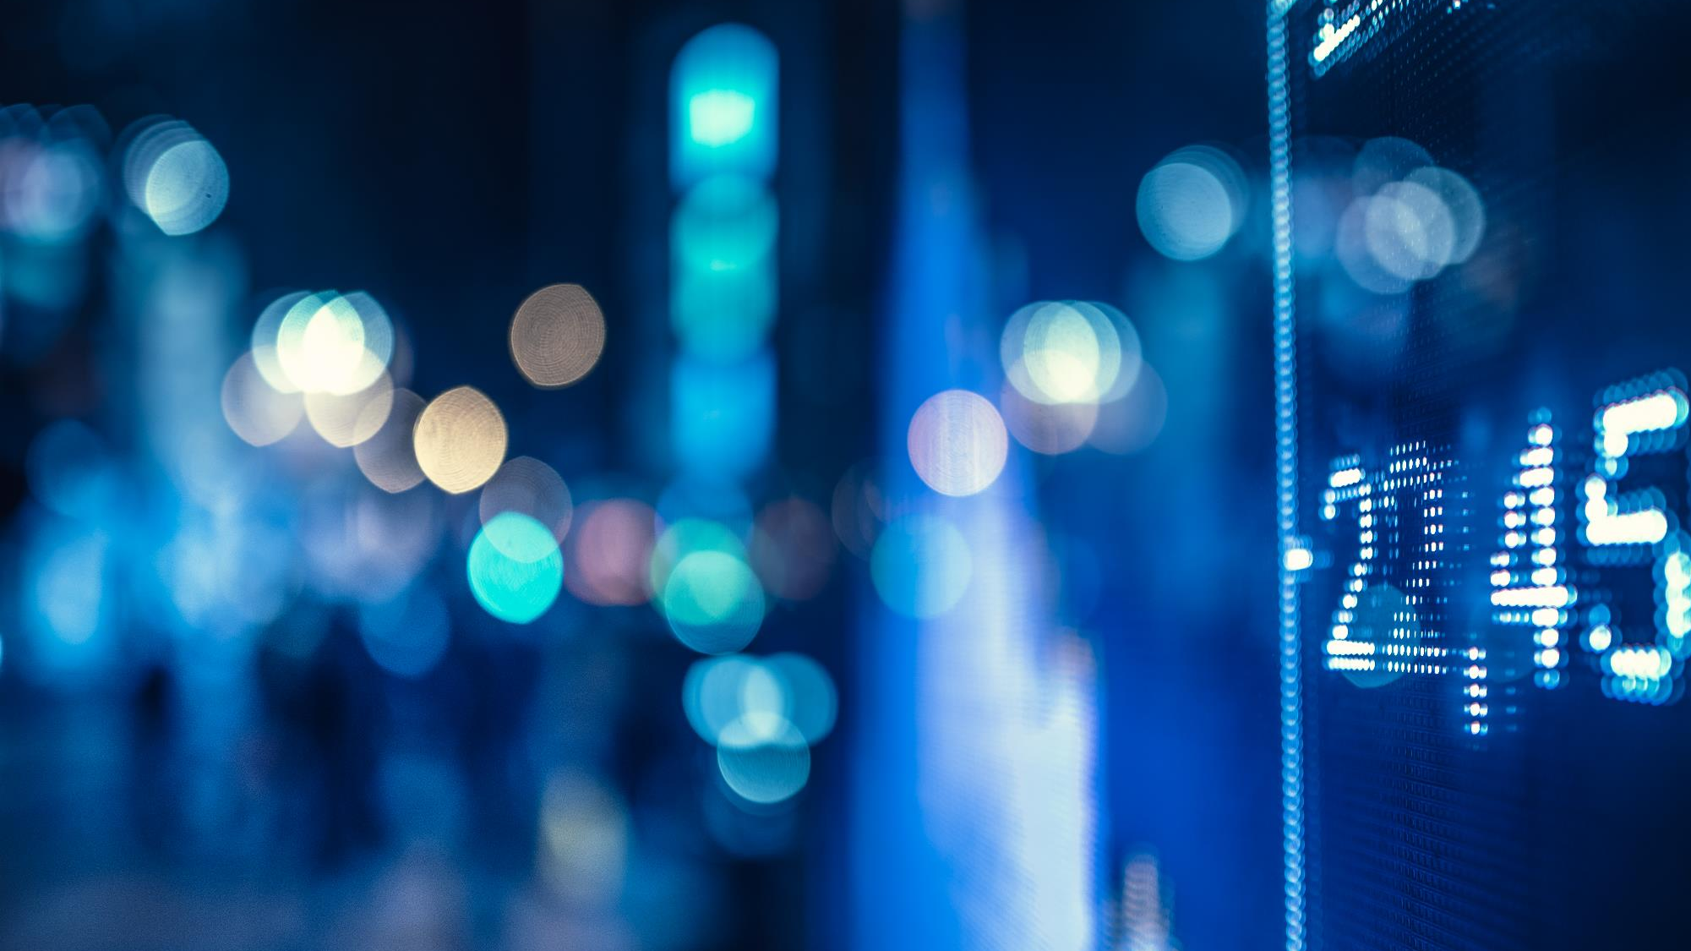
outline
Point Lights
Multiple Lights
Spot Lights
Materials
Directional Lights
Lighting maps

Slide 3
Lighting maps
Usually, real objects are made of different materials.
Check objects around you
Notice different parts of a single object have different diffuse and specular effects.
To represent different parts of an object, we use diffuse and specular maps.
We use materials to define these maps for an object

Slide 4
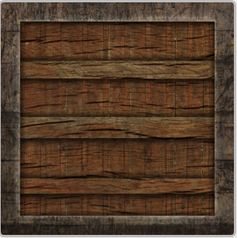
Lighting maps – diffuse maps
The diffuse map is usually the default texture for an object.
The middle part is made of wood and border is made of steel.
We used diffuse maps in previous weeks.

Slide 5
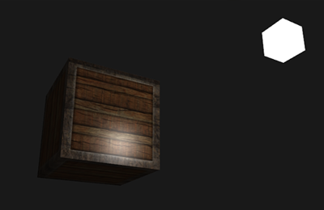
Lighting maps – SPECULAR maps
Render a cube with the diffuse shader discussed last week
Notice that the wood part of the object is reflecting light like a metal object.
It might be right for the polished wood but to represent normal wood we need to define Specular maps.

Slide 6
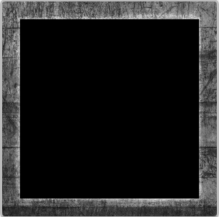
Lighting maps – SPECULAR maps
To solve the problem, we need to have a particular texture for the specular color calculation.
For the frame part, we can create a specific gray-scaled texture since it represents only brightness of reflected light.

Slide 7
Materials and lights
As our shaders become more complex, it becomes important to keep them organized
One way to do that is to define material and light structs in our shaders
This will group properties together in shaders that define texture and light qualities of the mesh being rendered

Slide 8
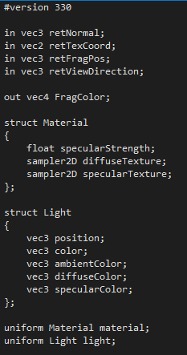
Materials and lights – diffuse.fragmentshader (1/2)
Use structs to define materials and lights
Same as c structs
Notice 2 samplers, 1 for diffuse and 1 for specular map
Then define a variable from the struct type
Access the variable from the client application using e.g., light.color

Slide 9
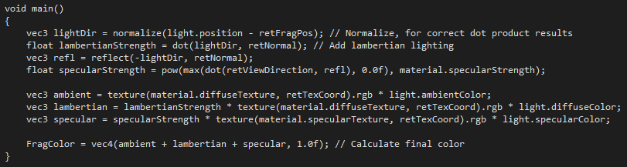
Materials and lights – diffuse.fragmentshader (2/2)
Replace variable names with struct.variablename
Use both diffuse and specular maps (textures) to calculate the diffuse and specular color during the render pass

Slide 10
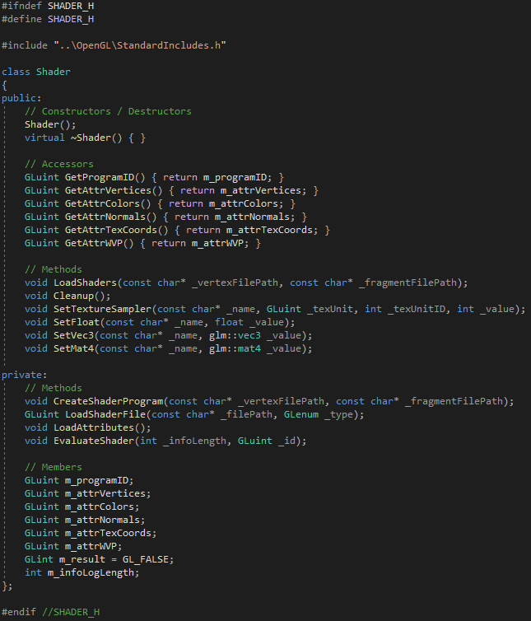
Materials and lights – shader.h
Remove the sampler members and accessors (they are part of the materials now)
Add a SetTextureSampler method

Slide 11
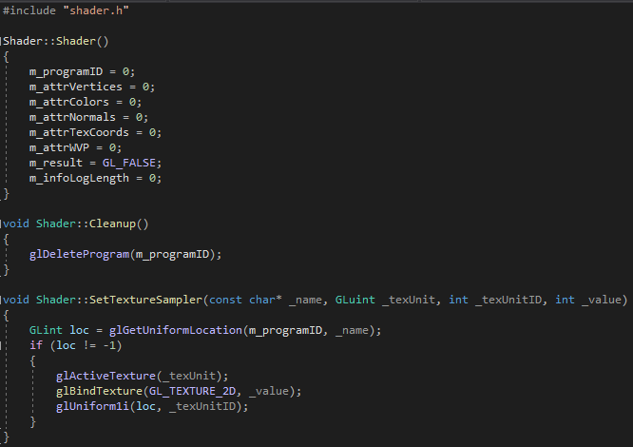
Materials and lights – shader.CPP (1/2)

Slide 12
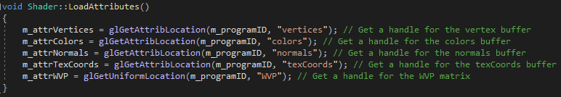
Materials and lights – shader.CPP (2/2)
Remove the code getting the sampler locations from LoadAttributes

Slide 13
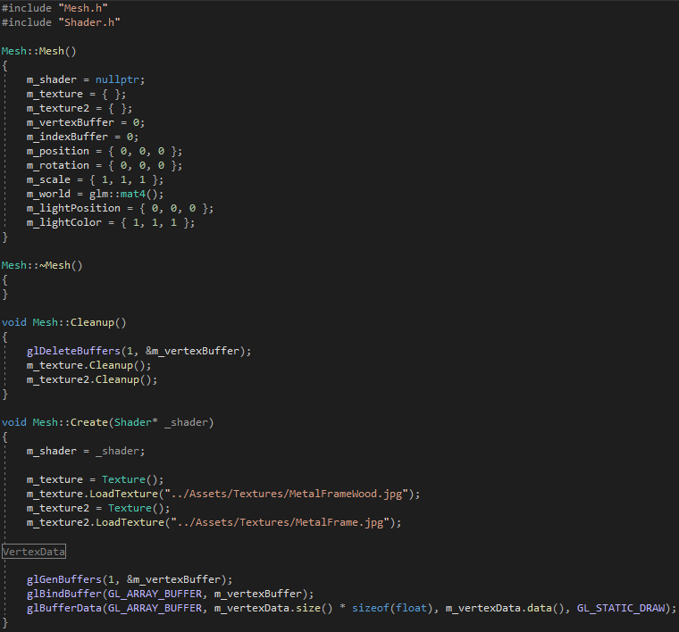
Materials and lights – MESH.CPP (1/3)

Slide 14
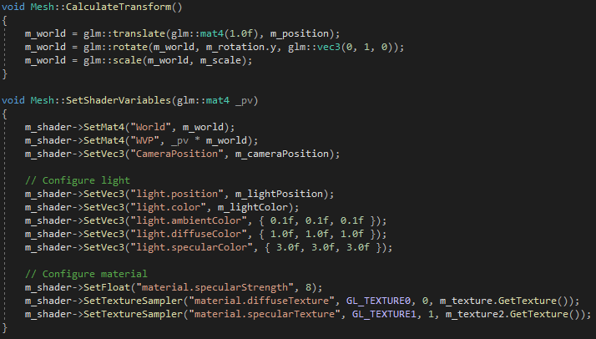
Materials and lights – MESH.CPP (2/3)

Slide 15
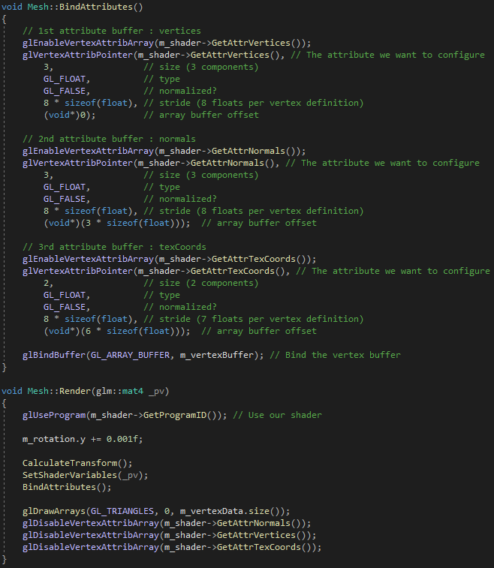
Materials and lights – MESH.CPP (3/3)

Slide 16
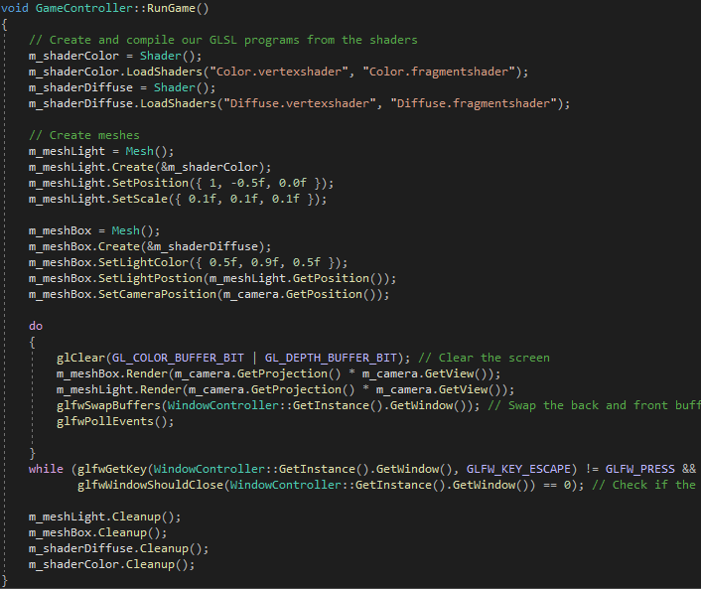
Materials and lights – GameController.cpP

Slide 17
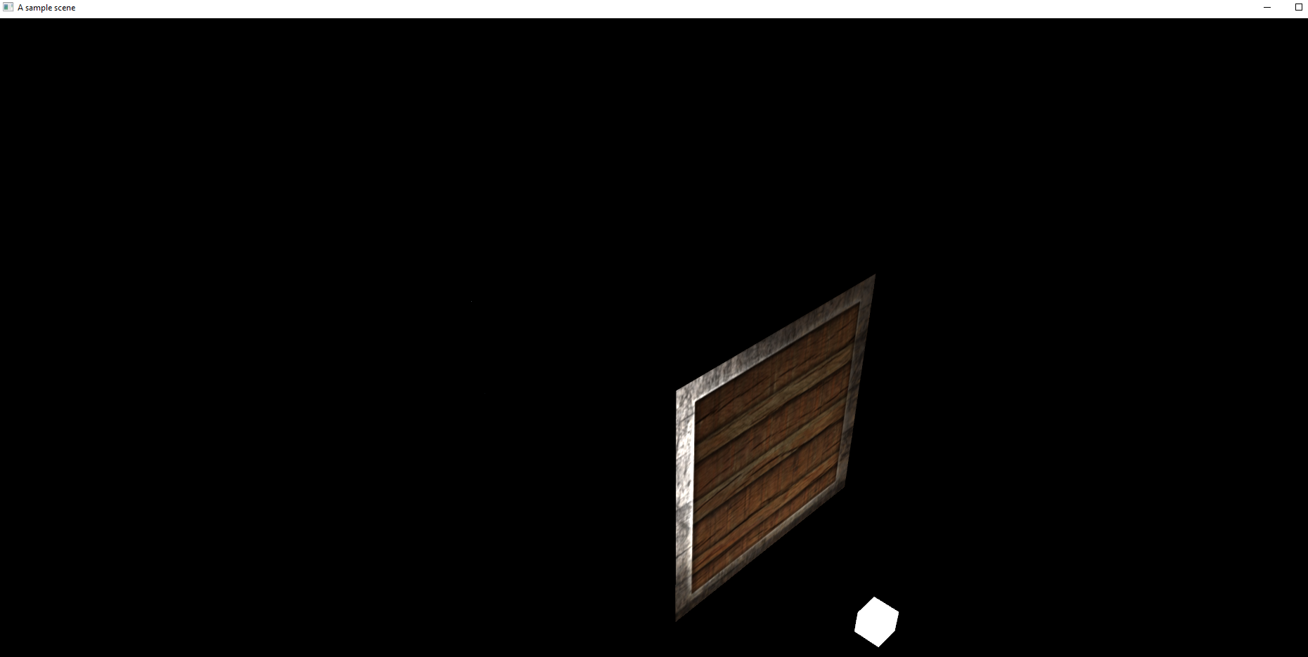
Materials and lights – OUTPUT

Slide 18
Materials and lights – multiple cubes
Let’s see how the light affects multiple cubes in a scene
For this, we will add a vector of cubes to our game controller
We will add 10 cubes and also randomize the positions of the cubes in the scene

Slide 19
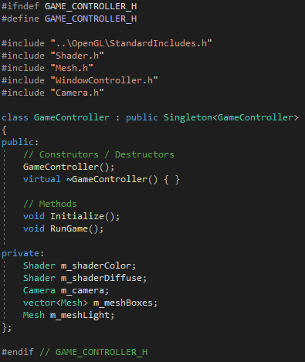
Materials and lights – multiple cubes – gamecontroller .h

Slide 20
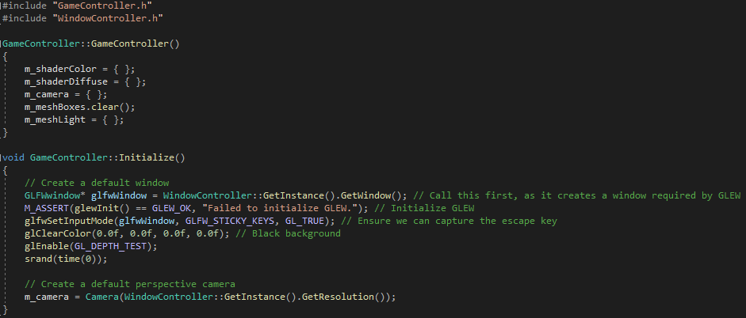
Materials and lights – multiple cubes – gamecontroller .CPP (1/3)

Slide 21
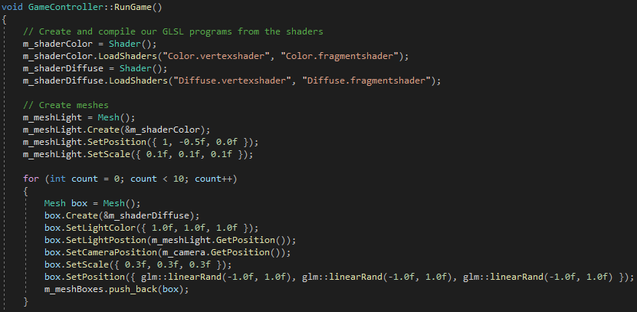
Materials and lights – multiple cubes – gamecontroller .CPP (2/3)

Slide 22
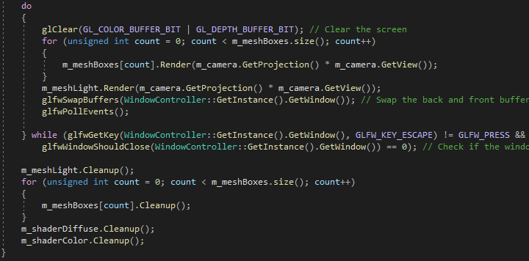
Materials and lights – multiple cubes – gamecontroller .CPP (3/3)

Slide 23
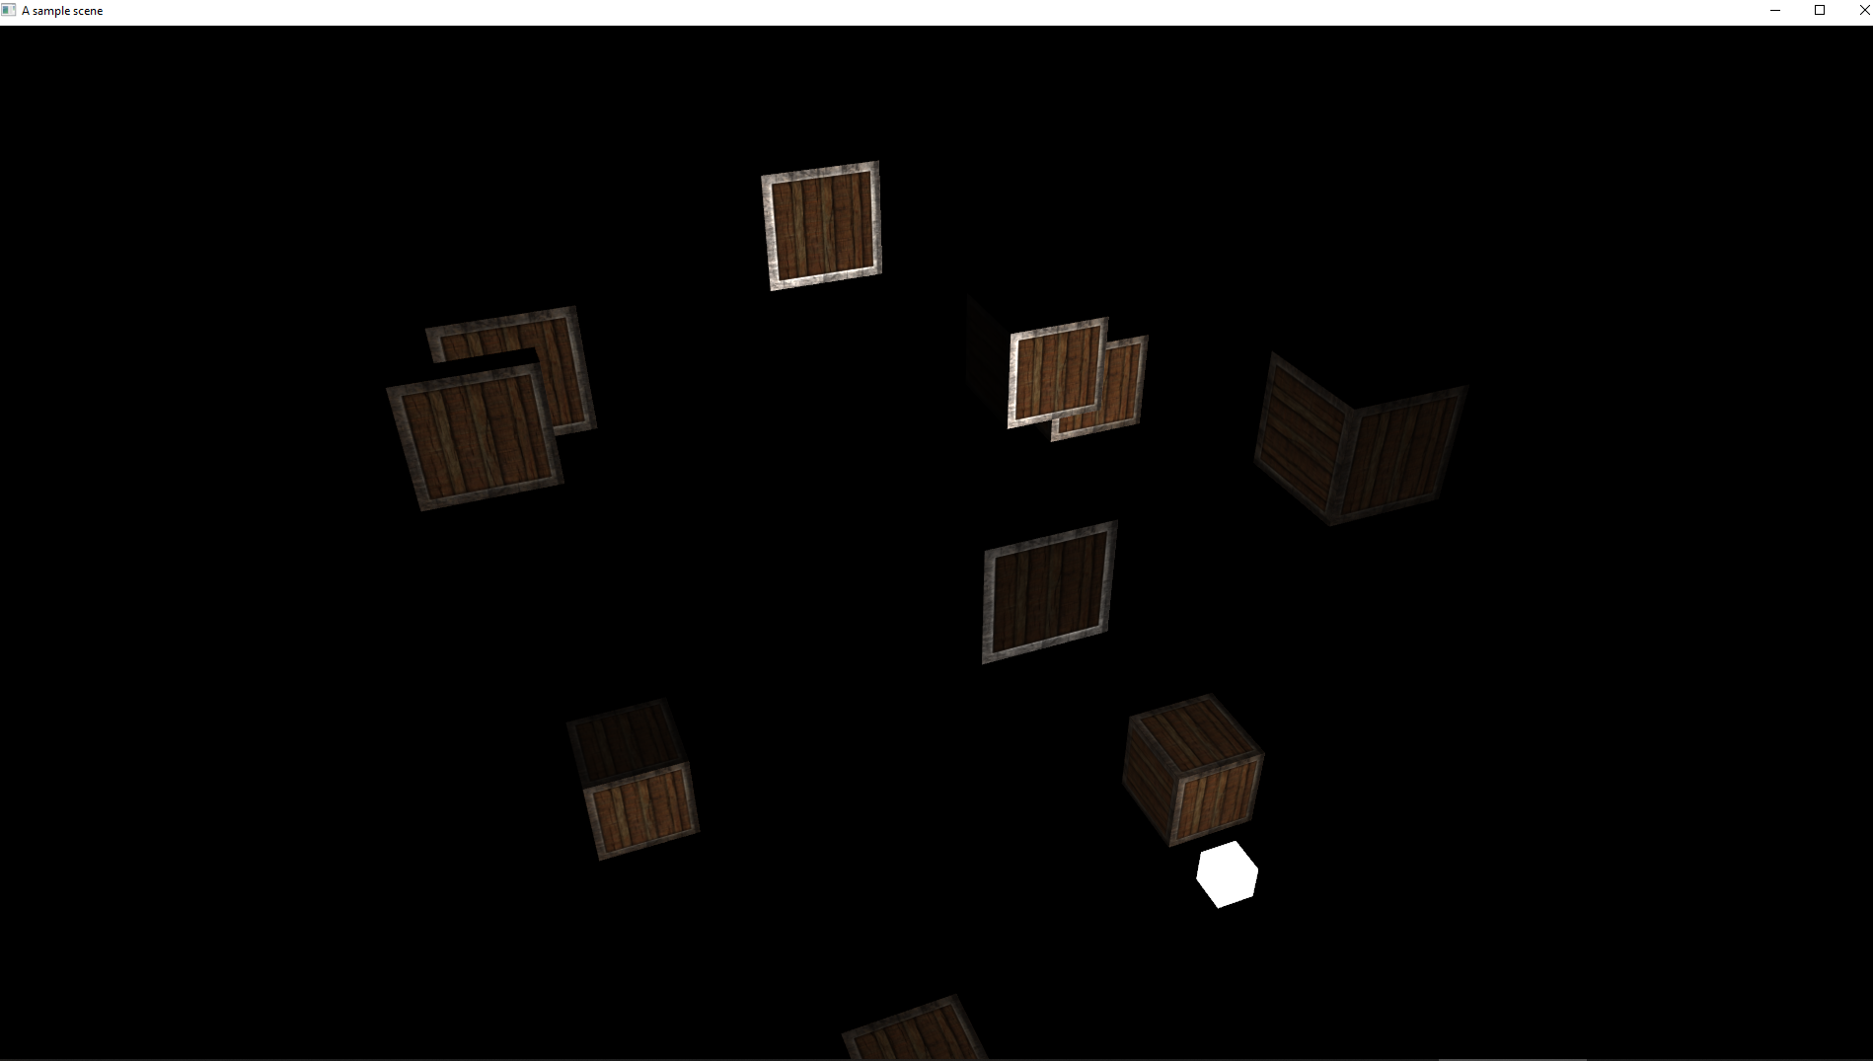
Materials and lights – multiple cubes – output)

Slide 24
Task 1
Create a shader that defines a material and light struct
For the material, define a diffuse and specular sampler
Render a cube with specular and diffuse lighting

Slide 25
Task 2
Render multiple cubes

Slide 26
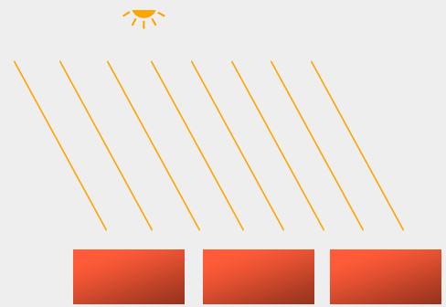
Light sources – Directional light
Light acts as waves. Rays of the light source spread like sphere.
If the light source is far enough, rays are considered parallel.
Such light source, like the sun, is called directional light.

Slide 27
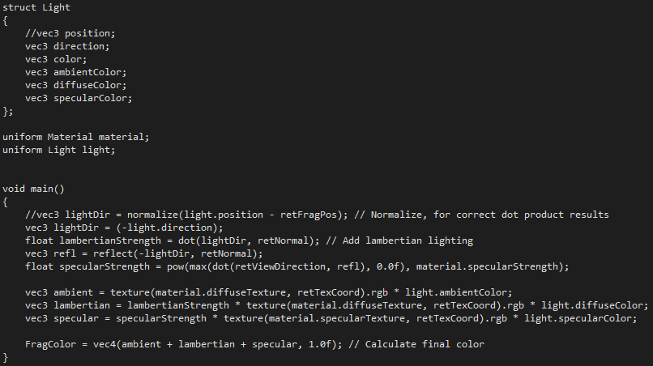
Light sources – Directional light – diffuse.FRAGMENTshader
For directional light, the position of the light is irrelevant.
Instead, the direction is important for the light calculation.
The negation represents the direction toward the light source.
Since we have the light direction, the rest of the color calculation for diffuse and specular are the same as before.

Slide 28
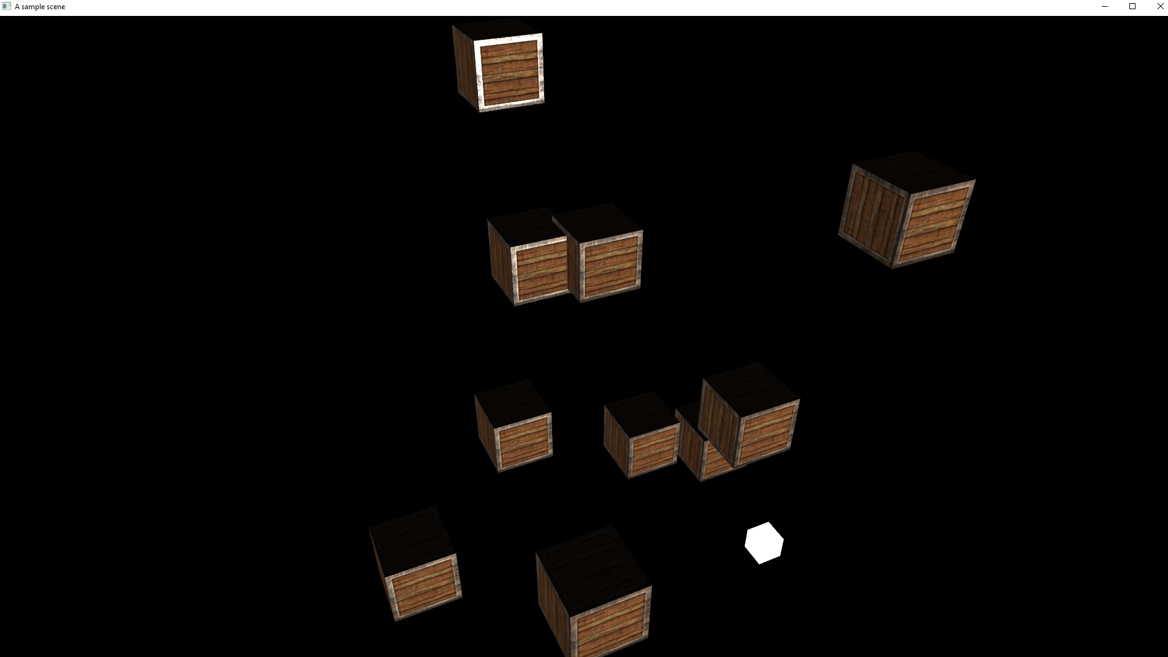
Light sources – Directional light - output

Slide 29
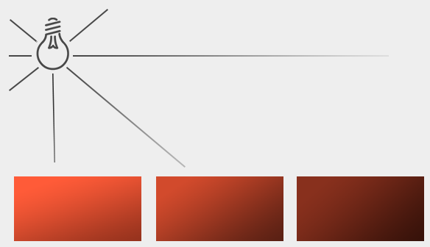
Light sources – point light
Usually in addition of the directional light, we have several point lights in a scene.
A point light has a position in a scene such as light bulbs.
Point light rays fade out over distance.
Our light sources used in last week were point lights with powerful illuminations which never faded out.

Slide 30
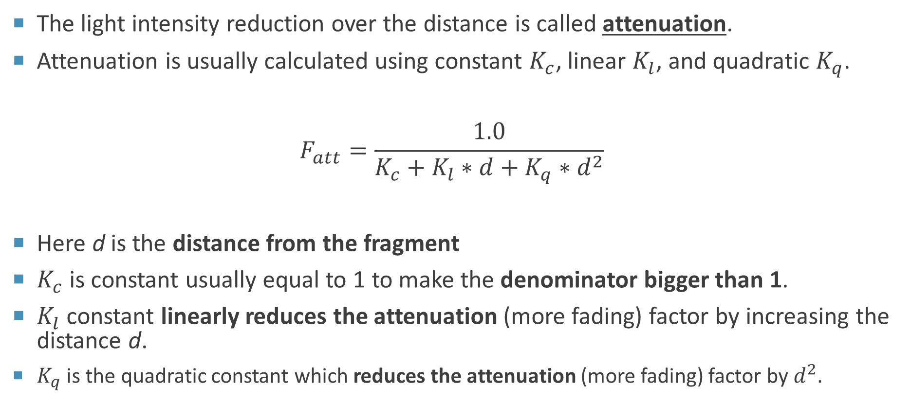
Light sources – point light
The light intensity reduction over the distance is called attenuation.
Attenuation is usually calculated using constant $K_{c}$, linear $K_{l}$, and quadratic $K_{q}$.
$$F_{att}=\frac{1.0}{K_{c}+K_{l}∗d+K_{q}∗d^{2}}$$
Here d is the distance from the fragment
$K_{c}$ is constant usually equal to 1 to make the denominator bigger than 1.
$K_{l}$ constant linearly reduces the attenuation (more fading) factor by increasing the distance d.
$K_{q}$ is the quadratic constant which reduces the attenuation (more fading) factor by $d^{2}.$

Slide 31
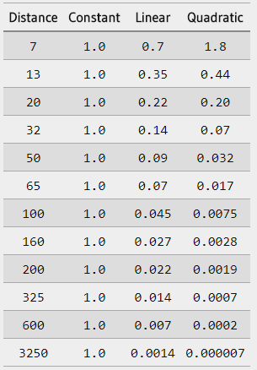
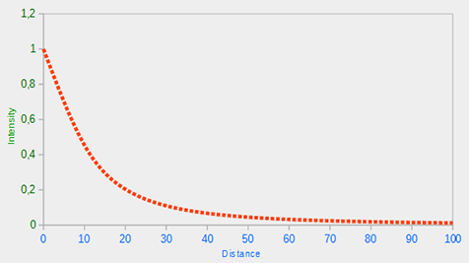
Light sources – point light
The following graph shows the attenuation factor using the att formula:

Slide 32
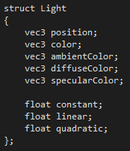
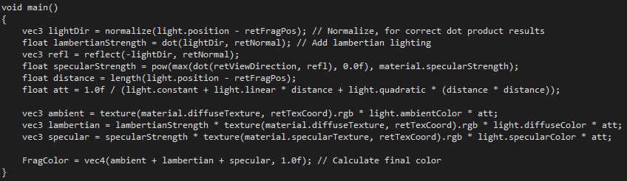
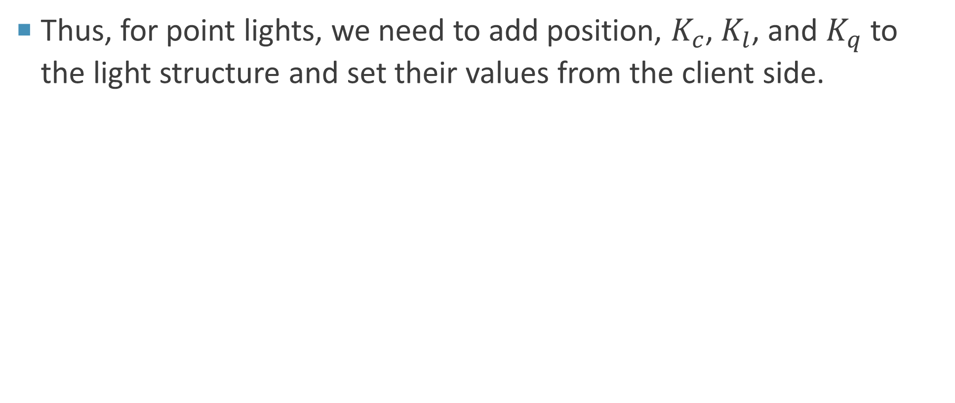
Light sources – point light – diffuse.fragmentshader
Thus, for point lights, we need to add position, $K_{c}$, $K_{l}$, and $K_{q}$ to the light structure and set their values from the client side.

Slide 33
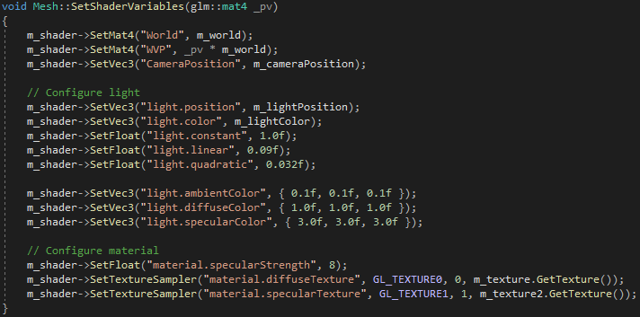
Light sources – point light – mesh.cpp

Slide 34
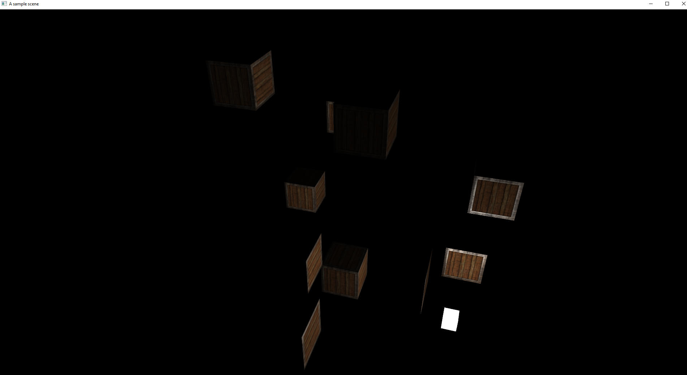
Light sources – point light - OUTPUT

Slide 35
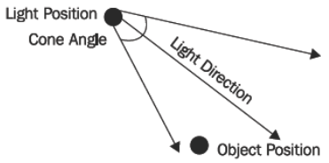
Light sources – spotlight
A spotlight:
fades after given distance
does not fade around the light source
angle calculated using:
direction between light source and object and
actual light direction
if angle > cone angle, use ambient light only

Slide 36
Light sources – spotlight
Described by the formula:
K_{att} = (dot(p – lp, ld) / cos(a))^{f}
K_{att} - the brightness scalar that we will multiply the lighting amount by
p - the world position of the vertex
lp - the light position
ld - the light direction
a - the cone angle
f - the falloff exponent

Slide 37
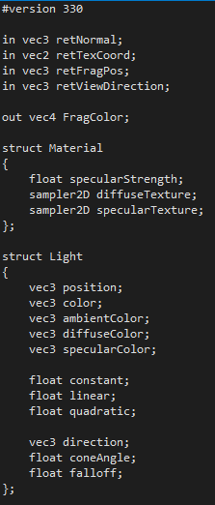
Light sources – spotlight – diffuse.fragmentshader (1/2)
Add spotlight components to the light struct

Slide 38
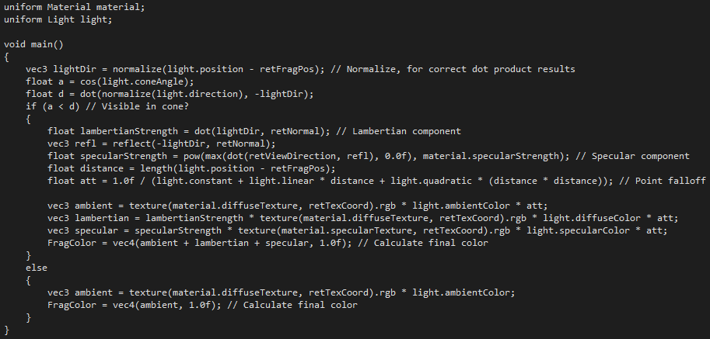
Light sources – spotlight – diffuse.fragmentshader (2/2)

Slide 39
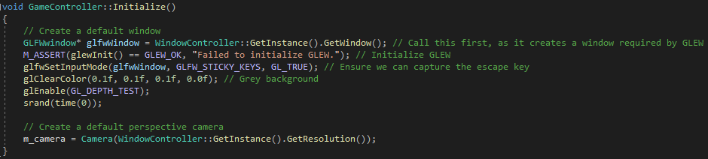
Light sources – spotlight – gamecontroller.cpp (1/2)

Slide 40
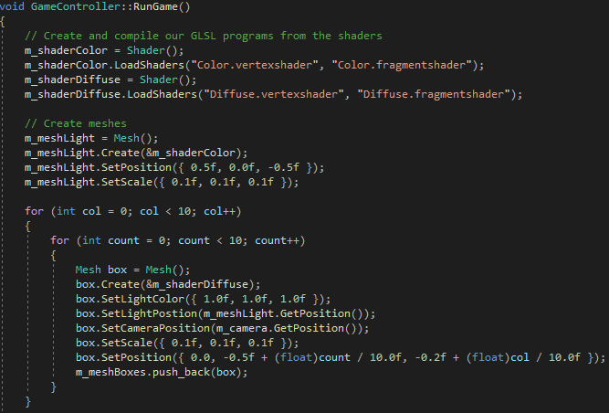
Light sources – spotlight – gamecontroller.cpp (2/2)

Slide 41
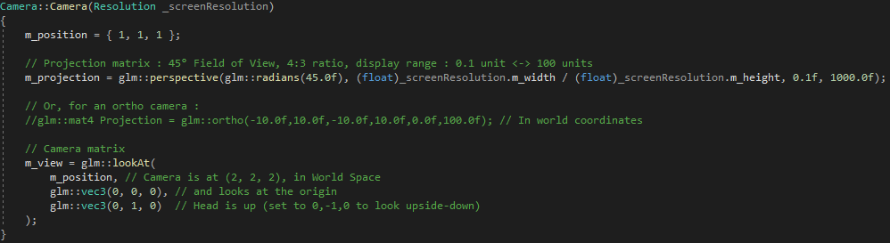
Light sources – spotlight – camera.cpp

Slide 42
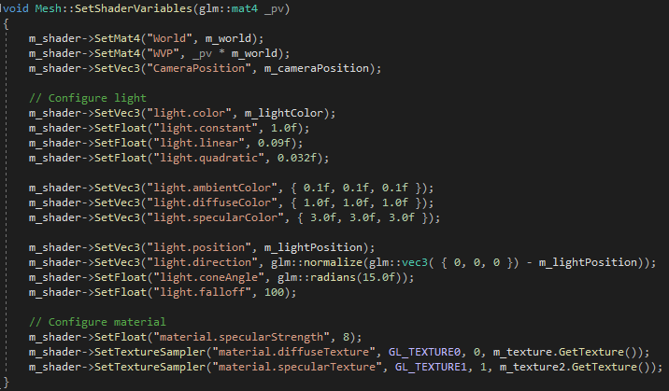
Light sources – spotlight – MESH.cpp

Slide 43
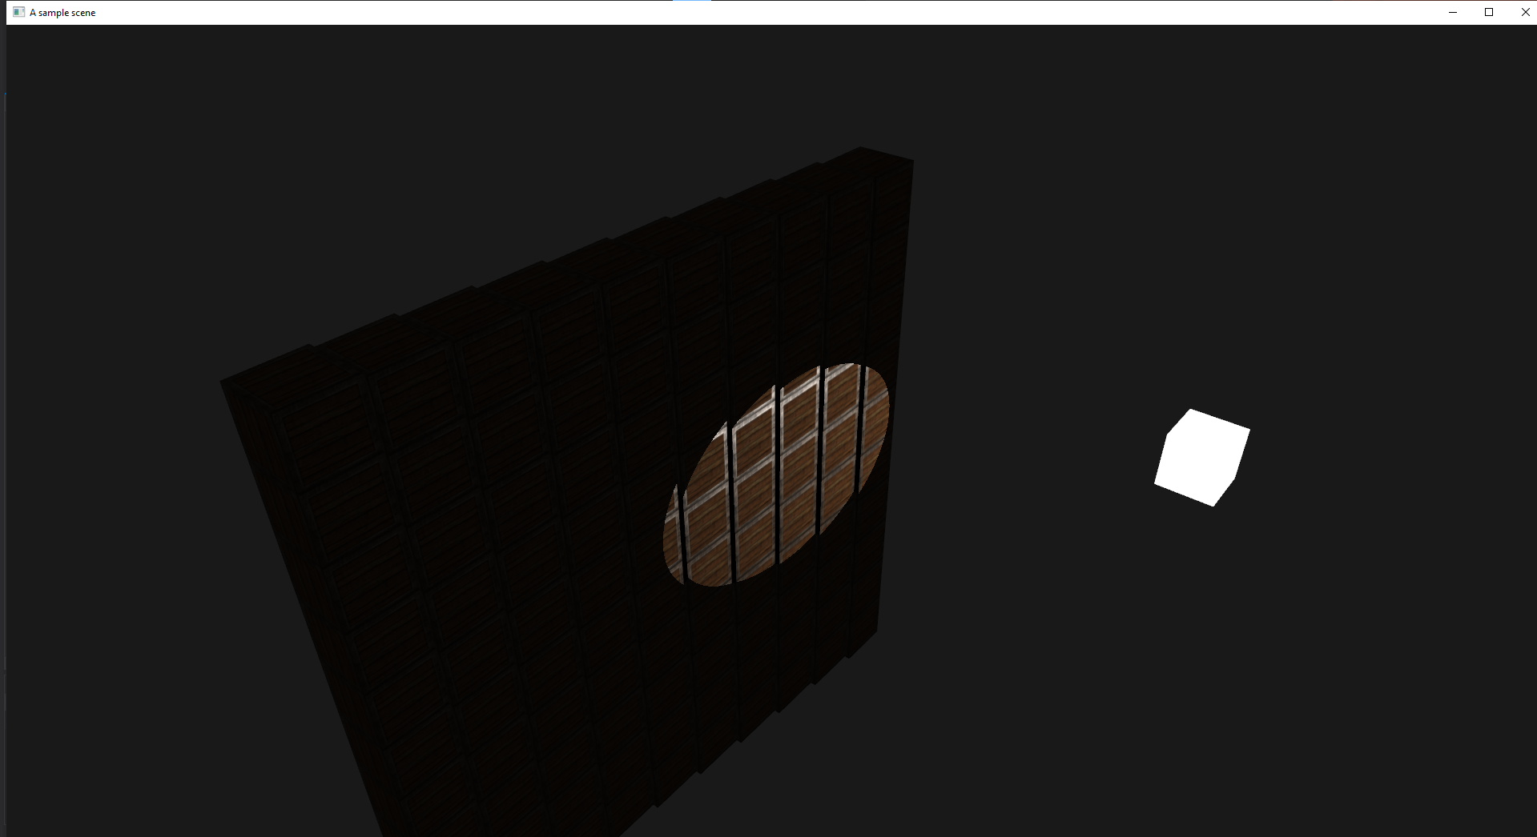
Light sources – spotlight – output

Slide 44
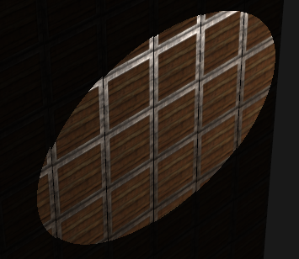
Light sources – spotlight
One problem with the previous output, is that the spotlight has no gradual falloff.
An object falling in the cone is lit 100%, and just outside the cone is lit 0%
This is not realistic and creates sharp edges

Slide 45
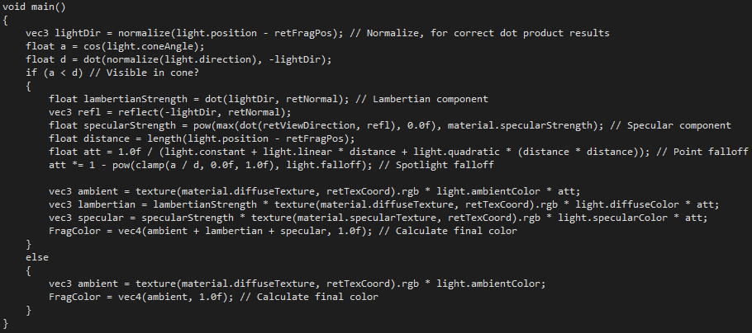
Light sources – spotlight – diffuse.fragmentshader

Slide 46
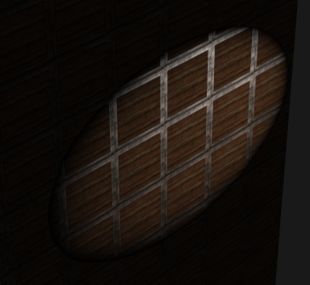
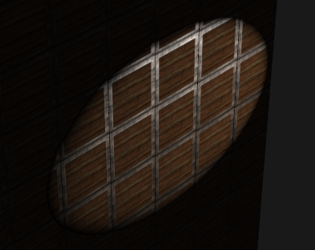
Light sources – spotlight – output
Falloff: 100
Falloff: 200

Slide 47
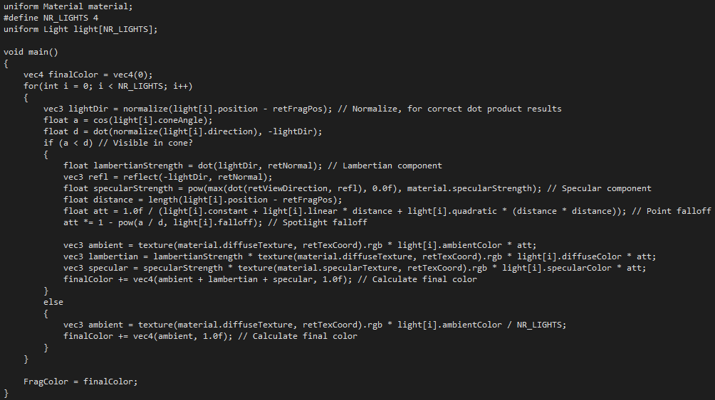
Light sources – multiple lights - diffuse.fragmentshader

Slide 48
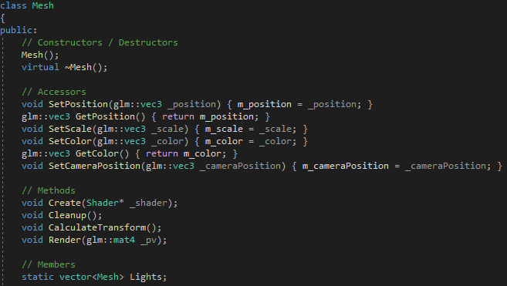
Light sources – multiple lights – Mesh.H (1/2)

Slide 49
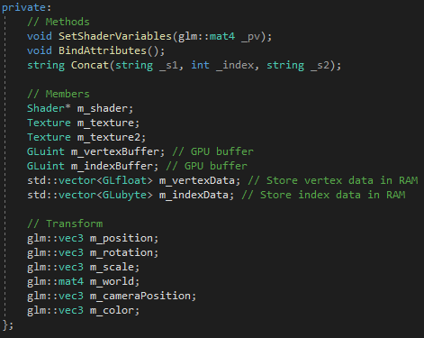
Light sources – multiple lights – Mesh.H (2/2)

Slide 50
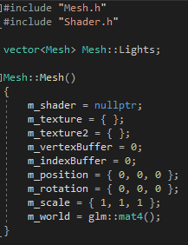
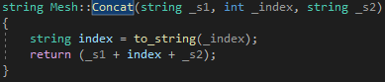
Light sources – multiple lights – Mesh.CPP (1/2)

Slide 51
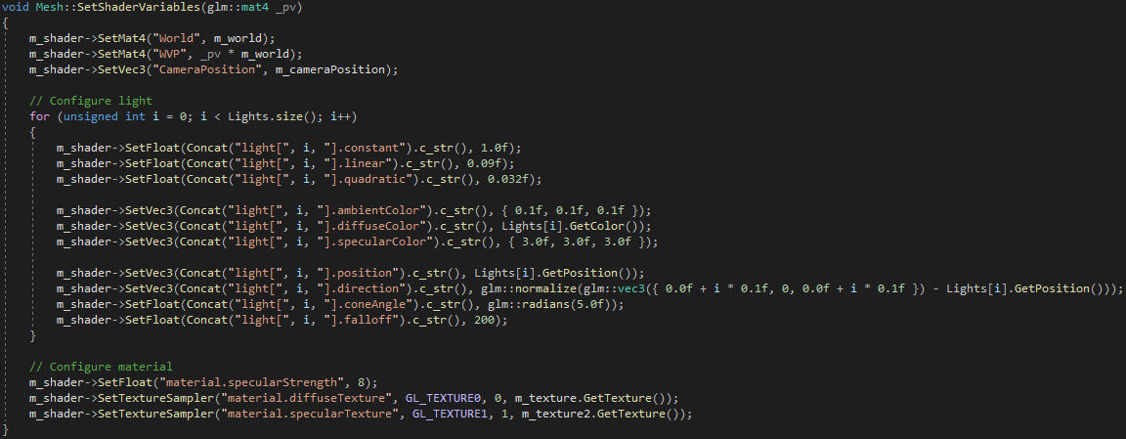
Light sources – multiple lights – Mesh.CPP (2/2)

Slide 52
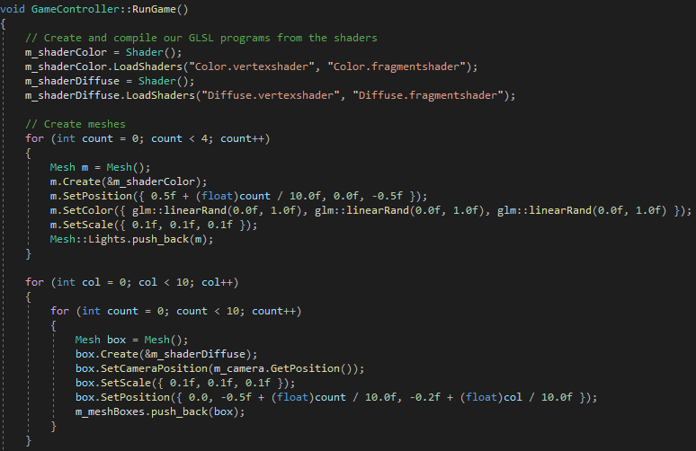
Light sources – multiple lights – gamecontroller.cpp

Slide 53

Light sources – multiple lights - output

Slide 54
Task 3
Create a working shader that will simulate a Point Light
Play around with the new lighting variables and observe the effect changing them has

Slide 55
Task 4
Create a working shader that will simulate a Spotlight
Play around with the new lighting variables and observe the effect changing them has

Slide 56
Task 5
Create a working shader that will simulate Multiple Lights
Render at least 5 lights
Move the teapot around the scene and observe the influence the multiple lights has

Slide 57

Thank You

